Slide 1
Mapping to the CIDOC CRM Basic Overview
George Bruseker ICS-FORTH
24/4/2017

Slide 2
Table of Contents
Pre-requisites for Mapping
Understanding, Materials, Tools
Mapping Method
Source Analysis, Target Analysis
Mapping Recipe
Mapping Example

Slide 3
1. Mapping Pre-Requisites

Slide 4

What do I need to do a mapping? Understanding
The Knowledge
Know your source!
What the field intends to document not what its label says it is
What the data in the field actually is. Was it used for it?
Know your target!
Study

Slide 5
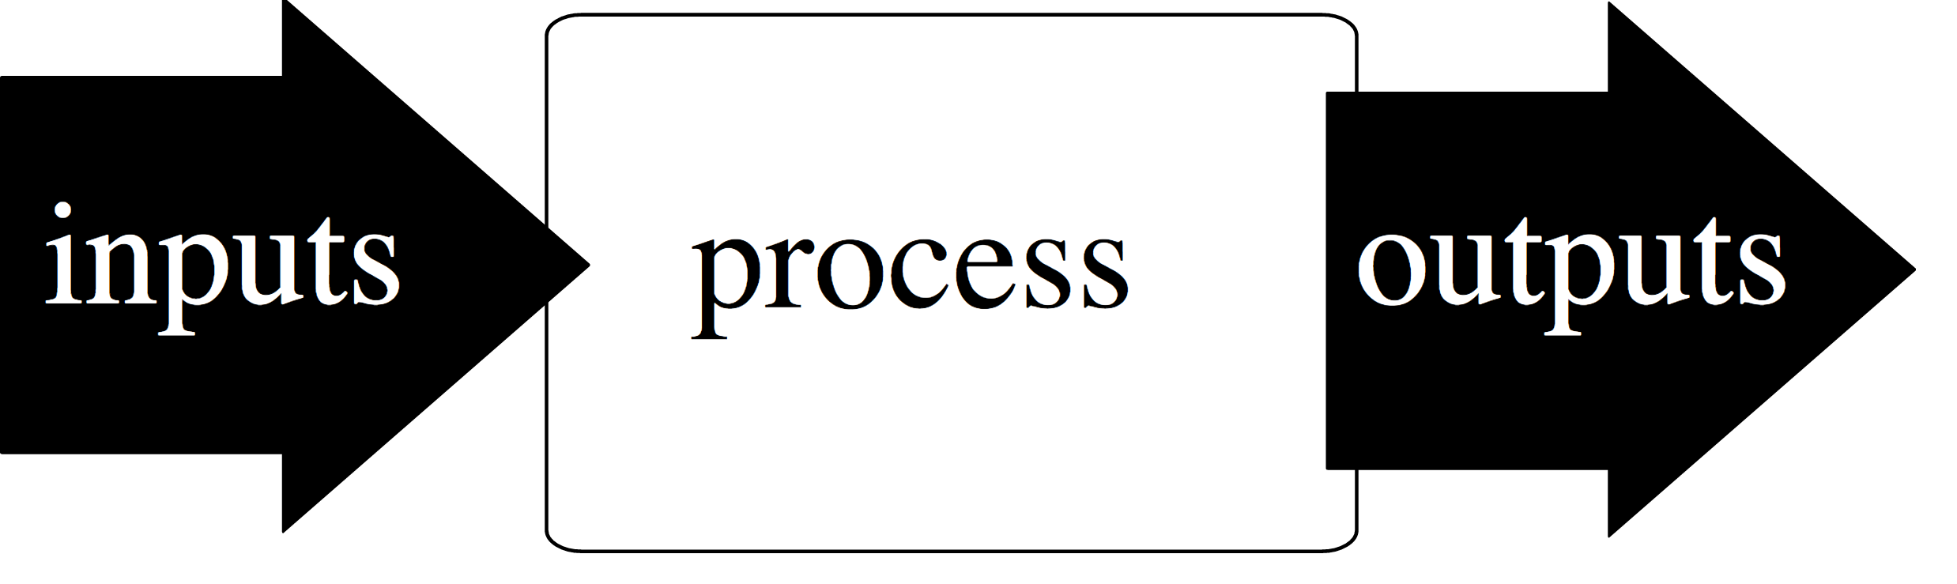
What do I need to do a mapping? Materials
The Documents
Source
Description of the Schema
Copy of the encoded Schema
Sample Data
Target!
Description of the Ontology
Encoding of the Ontology
CRM @ http://www.cidoc-crm.org/

Slide 6


What do I need to do a mapping? Tools
The Tools
Planning
Pen and Paper
Time
Executing
A Mapping software
Time
3M @ http://139.91.183.3/3M/Login

Slide 7
2. Mapping Method

Slide 8
Mapping Method: Analyzing the Source
Questions to ask
What is the schema about? i.e.: what is the subject of the data structure?
What kind of statement does each field make about the subject?
Tip
Think of the natural language sentences / propositions that the data structure encodes
For the overall schema write ‘There is an X’ where X = subject
For each field write ‘X is called’, ‘was created in year’ etc.

Slide 9
Crimea Conference Historical Archives….
The whole schema says:
There is a document
The fields say:
The document has a type
The document has a title
The document has a second title
The document came into existence at a date
The document was created by 1 or more people
The document was published by one or more institutions
The document is relevant to a particular subject
Field | Value
Type | Text
Title | Protocol of Proceedings of Crimea Conference
Subtitle | Declaration of Liberated Europe
Date | February 11, 1945
Creator | The Premier of the Union of Soviet Socialist Republics The Prime Minister of the United Kingdom The President of the United States of America
Publisher | State Department
Subject | Postwar division of Europe and Japan

Slide 10
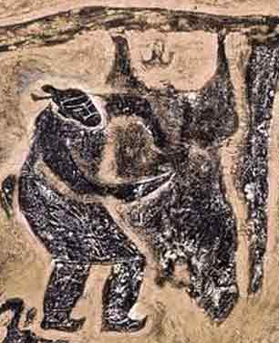
Mapping Method: Understanding the Target
Read / Question / Understand the Top Level Classes
For each ask:
What kind of things does it allow me to talk about?
What does it allow me to say about that kind of thing?
Think about the nature of the object that the source is talking about and what it says about it
Are the target class and its relations adequate to express this?
Do I want/need to say more?

Slide 11
Mapping Method: CIDOC CRM Top Level Classes
E1 Entity
E2 Temporal Entity
E77 Persistent Item
E53 Place
E28 Conceptual Object
E18 Physical Thing
E39 Actor
To anything I can give a name or a type
Some things are consistent in identity through time (objects) while some change (temporal entities) but have an identity overall
Of objects we can distinguish: conceptual things (that are not limited to one instances), physical things which are unique, and actors which have the unique property of agency in the world
Places define a geometric location bound to some object in time

Slide 12
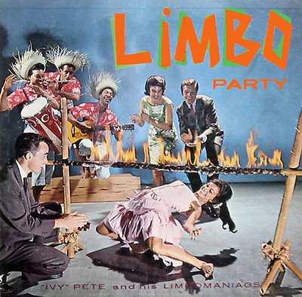
Mapping Method: Using the Target
Formal Ontologies are arranged hierarchically.
The highest classes are the most abstract and define - through their relations - the highest levels of discourse within a domain. These are your starting point for understanding/mapping.
Everything that can be said about a superclass can also be said of a subclass. Everything that can be said about a super relation can be said of its subrelation
Once you find the branch of the hierarchy where you concept fits… find how low you can go!
E1 Entity
E2 Temporal Entity
E4 Period
E5 Event

Slide 13
E1 What you can say about anything
E1 CRM Entity
Scope | This class comprises all things in the universe of discourse of the CIDOC Conceptual Reference Model.
Relations | P1 is identified by (identifies): E41 Appellation P2 has type (is type of): E55 Type P3 has note: E62 String
For the Crimean document example, let’s assume: Whole thing = E1
This allows us to say:
title = E1 CRM Entity p1 is identified by E41 Appellation
type = E1 CRM Entity p2 has type E55 Type
But we obviously need to say more. So, we descend the hierarchy.

Slide 14
E2 Expressing things about time
E2 Temporal Entity
Scope | This class comprises all phenomena, such as the instances of E4 Periods, E5 Events and states, which happen over a limited extent in time. In some contexts, these are also called perdurants.
Relations | P4 has time-span (is time-span of): E52 Time-Span …
For the Crimean document example, we must say: Whole thing != E2 Temporal Entity
The document as such is not an event; it has no time. But it results from an event.
We know there are dates associated to it so it implies that we will have to find a way to connect the document to an event.
I still need more expressive power to describe the document as such, but I know I will have to find it another branch of the ontology.

Slide 15
E77 talking about objects, what lasts
E77 Persistent Item
Scope | This class comprises items that have a persistent identity, sometimes known as “endurants” in philosophy. They can be repeatedly recognized within the duration of their existence by identity criteria rather than by continuity or observation.
Relations | -
For the Crimean document example, we can say: Whole thing = E77 Persistent Item
Whole thing = E1 CRM Entity but also E77 Persistent Item
E77 Persistent Item is more expressive
Finding a more particular class will give me more expressive power and allow me to express the other fields from the source.

Slide 16


How do I know when I have the right class?
Check Intension! Is the intension (scope) of the class I’m looking at in line with what I’m trying to describe?
Check relations! What does this class do? Does the thing it does cover the kinds of things I want to be able to talk about? If not, what’s missing? Could it be elsewhere?
Go a little further! Does the class work but it feels a bit too generic? Maybe you can go further. Try a step further down until the intension and/or properties don’t seem to fit.

Slide 17
3. Mapping Recipe

Slide 18
The Basic Mapping Recipe
Determine for the whole data structure, what class describes it in the target ontology. This is your Subject.
Determine for each field in the data structure, what class describes it in the target ontology. This is your Object.
Having understood the intended meaning of the field, select the relation or relations that will allow you to link Subject and Object. This is your Verb.
Repeat

Slide 19
Tip!
Mapping is NOT matching terms for terms
Ie.: I do not look for names of fields in the source and names of classes in the target and try to make their equivalence
Mapping is NOT tagging
Ie.: we do need to find the right classes for mapping, but the semantics come in choosing the correct relation / series of relations to translate the data
Mapping IS translating a data structure into formal propositions
Ie: my data will translate out into a triple structure that offers a pidgin version of natural language

Slide 20
4. Mapping Example

Slide 21
Crimea Conference Historical Archives….
Subject
E31 Document
Object
Field | Value
Type | Text
Title | Protocol of Proceedings of Crimea Conference
Subtitle | Declaration of Liberated Europe
Date | February 11, 1945
Creator | The Premier of the Union of Soviet Socialist Republics The Prime Minister of the United Kingdom The President of the United States of America
Publisher | State Department
Subject | Postwar division of Europe and Japan
E55 Type
E41 Appellation
E41 Appellation
E52 Time-Span
E21 Person
E40 Legal Body
E55 Type

Slide 22
Crimea Conference Historical Archives….
E55 Type
Post war Division of Europe
P129 is about
P2 has type
E31 Document
E55 Type
Field | Value
Type | Text
Title | Protocol of Proceedings of Crimea Conference
Subtitle | Declaration of Liberated Europe
Date | February 11, 1945
Creator | The Premier of the Union of Soviet Socialist Republics The Prime Minister of the United Kingdom The President of the United States of America
Publisher | State Department
Subject | Postwar division of Europe and Japan
Text
P1 is identified by
E41 Appellation
Protocol of Proceedings
P94 is was created by
P4 had time span
E65 Creation
E52 Time-Span
Signing of the Protocols
Feb 11, 1945
P14 carried out by
P14.i in the role of
E21 Person
Joseph Stalin
E55 Type
Premier of the USSR

Slide 23
Crimea Conference Historical Archives….mapped
Field | Value | CRM Translation = E31 Document
Type | Text | P2 has type E55 Type
Title | Protocol of Proceedings of Crimea Conference | p1 is identified by E41 Appellation
Subtitle | Declaration of Liberated Europe | p1 is identified by E41 Appellation
Date | February 11, 1945 | P94i was created by E65 Creation p4 has time-span E52 Time Span
Creator | The Premier of the Union of Soviet Socialist Republics etc. | P94i was created by E65 Creation p14 was carried out by E39 Actor
Publisher | State Department | P148i is component of E31 Document P94i was created by E65 Creation p14 was carried out by E39 Actor
Subject | Postwar division of Europe and Japan | P129 is about E55 Type

Slide 24
End
Time for mapping!
Questions:
George Bruseker
bruseker@ics.forth.gr
ICS-FORTH
http://www.ics.forth.gr/
CRM SIG
http://www.cidoc-crm.org/

